Slide 1
Indian Job Market Analysis.
Through Instahyre.

Slide 2
Indian Job Market Analysis :
Looking for jobs were a lengthier process.
Used tools to make a dashboard out of the data.
Helped in getting insights of different jobs available in Indian job market.

Slide 3
Problems Encountered:
Extraction of data through Web-Scrapping.
Cleaned the extracted data through SQL and made different tables accordingly .
Presented the tables through Ms-Excel.
Step 1 : Data Scrapping
Step 2 : Cleaning the data
Step 3 : Creating tables
Step 4 : Visualizing the data

Slide 4
Project Explanation :
Benefits of visualizing it through a dashboard.
Jobs availability in different cities of India.
Number of jobs across different industries across different location.
.

Slide 5
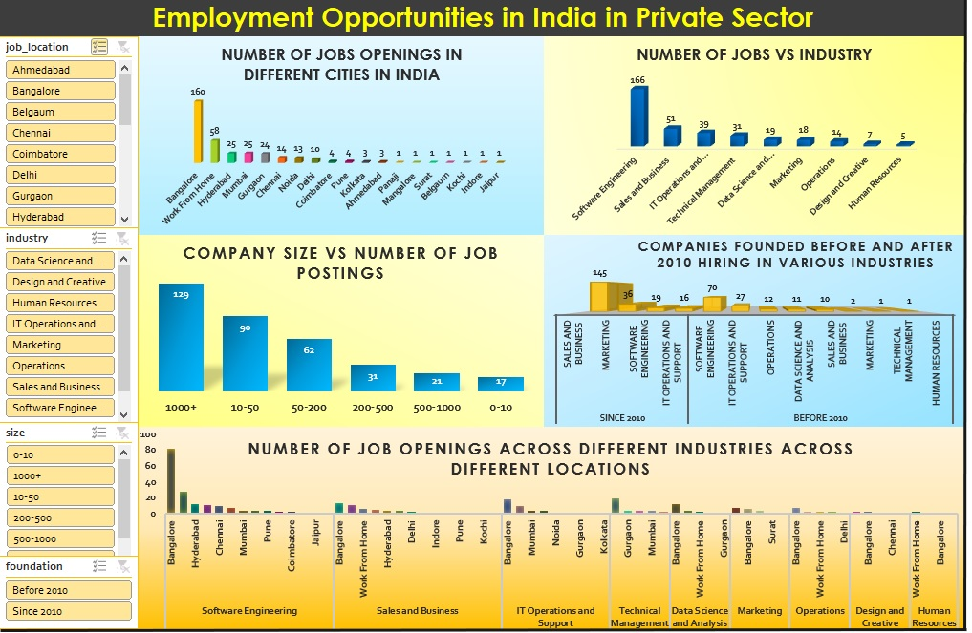
.

Slide 6
Interesting Insights From Dashboard :
Employees are getting the benefit of working remotely.
The IT-Sector are offering and have more openings of jobs as compared to other sectors.
It’s not necessary that the company with higher number of employee will hire more.
Another interesting insight we noticed is that after the boom in the Technology and increase in usage of more internet service resulted in boom in jobs in IT-Sector.
Also, Bangalore i.e., Silicon valley of India has higher openings of jobs in all sector, whether it be Tech/IT, Marketing, Operations, etc.

Slide 7
Conclusion :
There are more Tech Jobs in the market with different skills and experience.
The Startup industry is blooming and creating more jobs for the skilled youth.
The jobs are not only available at the metro cities now, it’s distributed all over the country.
Resulting in employees having the benefit of WFH.

Slide 8
Thanking You !!
- Sachin Ku Rai, Dipesh Bhatt, Siddhartha Agasti, Ranjit Sah.

